Slide 1
CS 2316 Group 2: NFL Combine and Career Performance Analysis
Dylan Both and Rian Rahman

Slide 2
Goal: Determine how effectively the NFL combine achieves its objective of determining which college talent has serious NFL potential
Why?
Improve how NFL teams analyze players
Improve how athletes prepare for their future careers

Slide 3
Hypothesis:
The degree to which combine performance predicts NFL career success will vary by position. More skill based positions, like quarterbacks, need not focus on the combine as much as other positions, like linebackers
Even in positions where combine performance is a good predictor of NFL success, there will be a few athletes with world class combine performances who do not succeed in the NFL

Slide 4
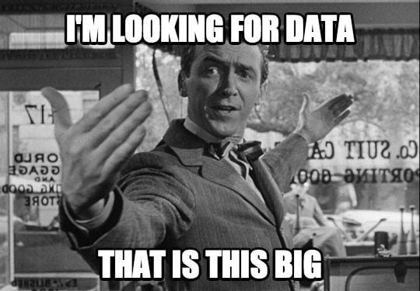
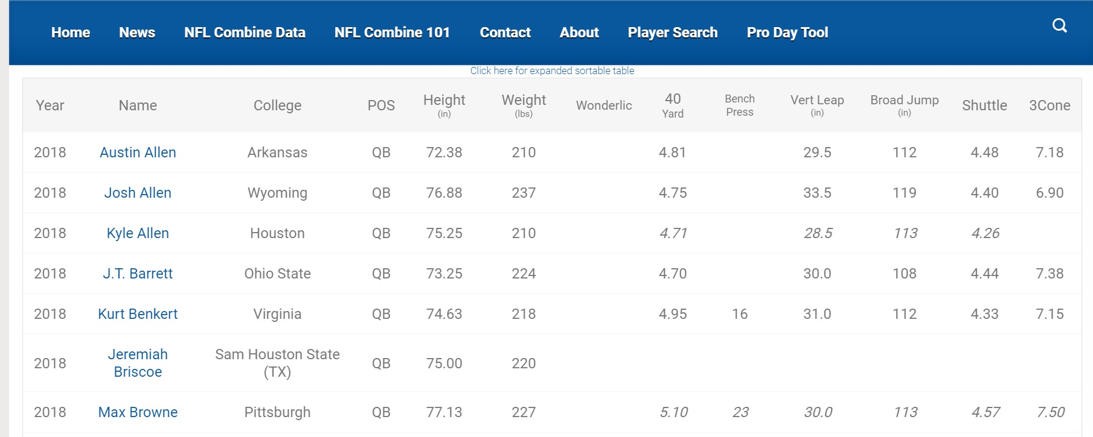
Data Collection Process:
Downloaded dataset:
Game log of every NFL game since 2019
Plenty of cleaning required
HTML:
Table containing scores spanning over many years
API:
One api to find the player ids
The second api contained the metrics
*Meme Credit: https://analyticsindiamag.com/10-memes-data-scientists-absolutely-love/

Slide 5
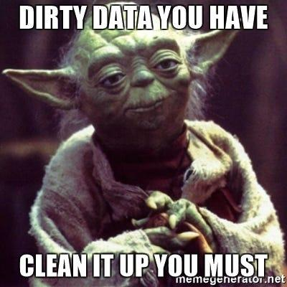
Data Cleaning:
Combine Data:
Get rid of empty rows
Store empty strings as None
Fix position abbreviations to match API
Game Log Data:
Fill missing team name columns
This required lots of context clues
Add winning_team column
Aggregate the total number of wins per team
API data:
Create a pandas dataframe with statistics that varied by position
*Meme Credit: https://miro.medium.com/v2/resize:fit:800/1*Xhm9c9qDfXa3ZCQjiOvm_w.jpeg

Slide 6
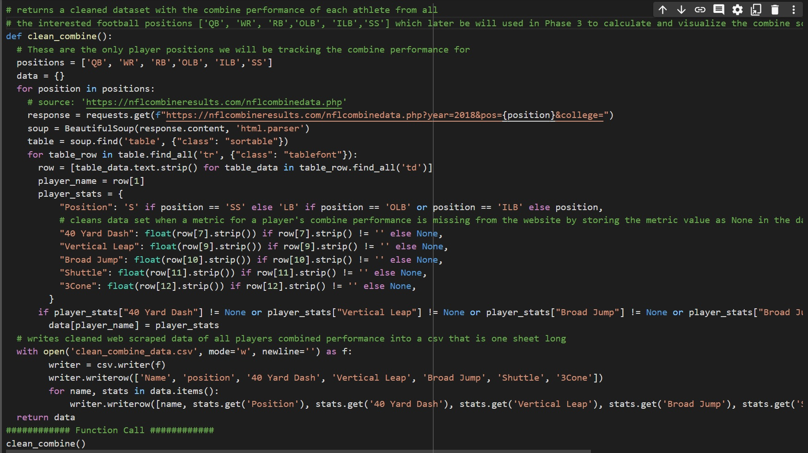
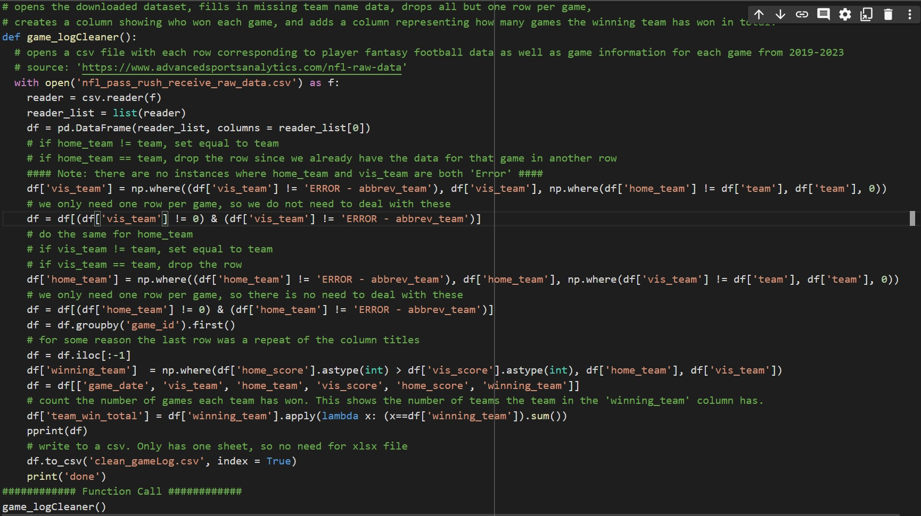
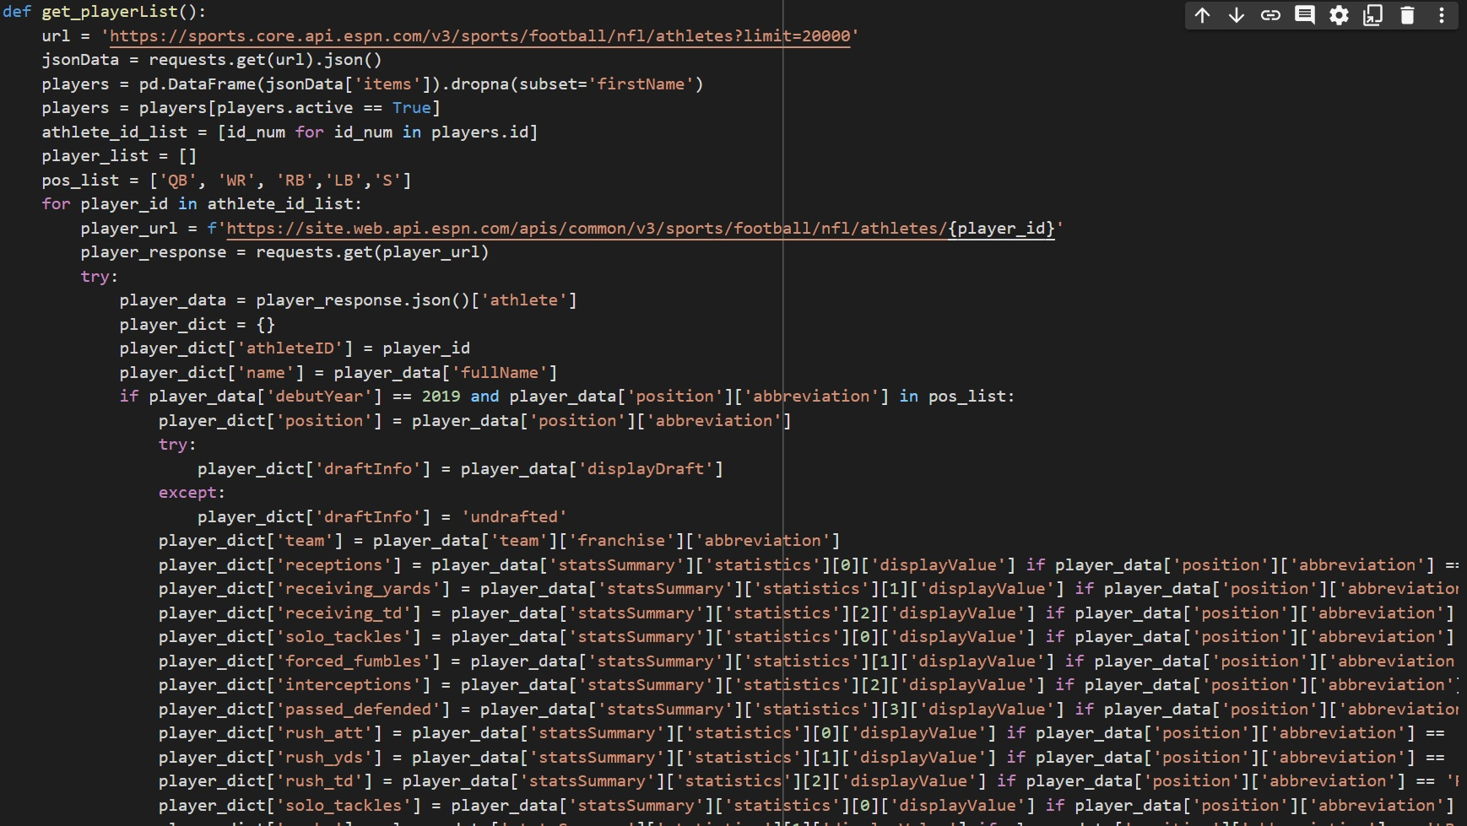
Data Cleaning Code:

Slide 7
Data Analysis:
In order to generate any insights, we had to create both combine scores and careers scores.
We created these scores by measuring each athletes performance in each drill/metric and creating a weighted average that reflects the relative importance of each drill/metric to that position.
Finally, we scaled each score relative to the top performer.
With these scores, we were able to create 5 insights and 3 visualizations.

Slide 8
Insight 1: Correlation Table
Our first insight was to create a correlation table that shows the correlation between combine score and career score by position.
This correlation has huge implications on the way NFL teams approach the recruitment process and the way athletes prepare for the combine. From the table, combine performance for player of positions RBs and WBs is a stronger indicator of how successful they will be in the NFL, suggesting that these prospects should spend the most time and money preparing for the NFL

Slide 9
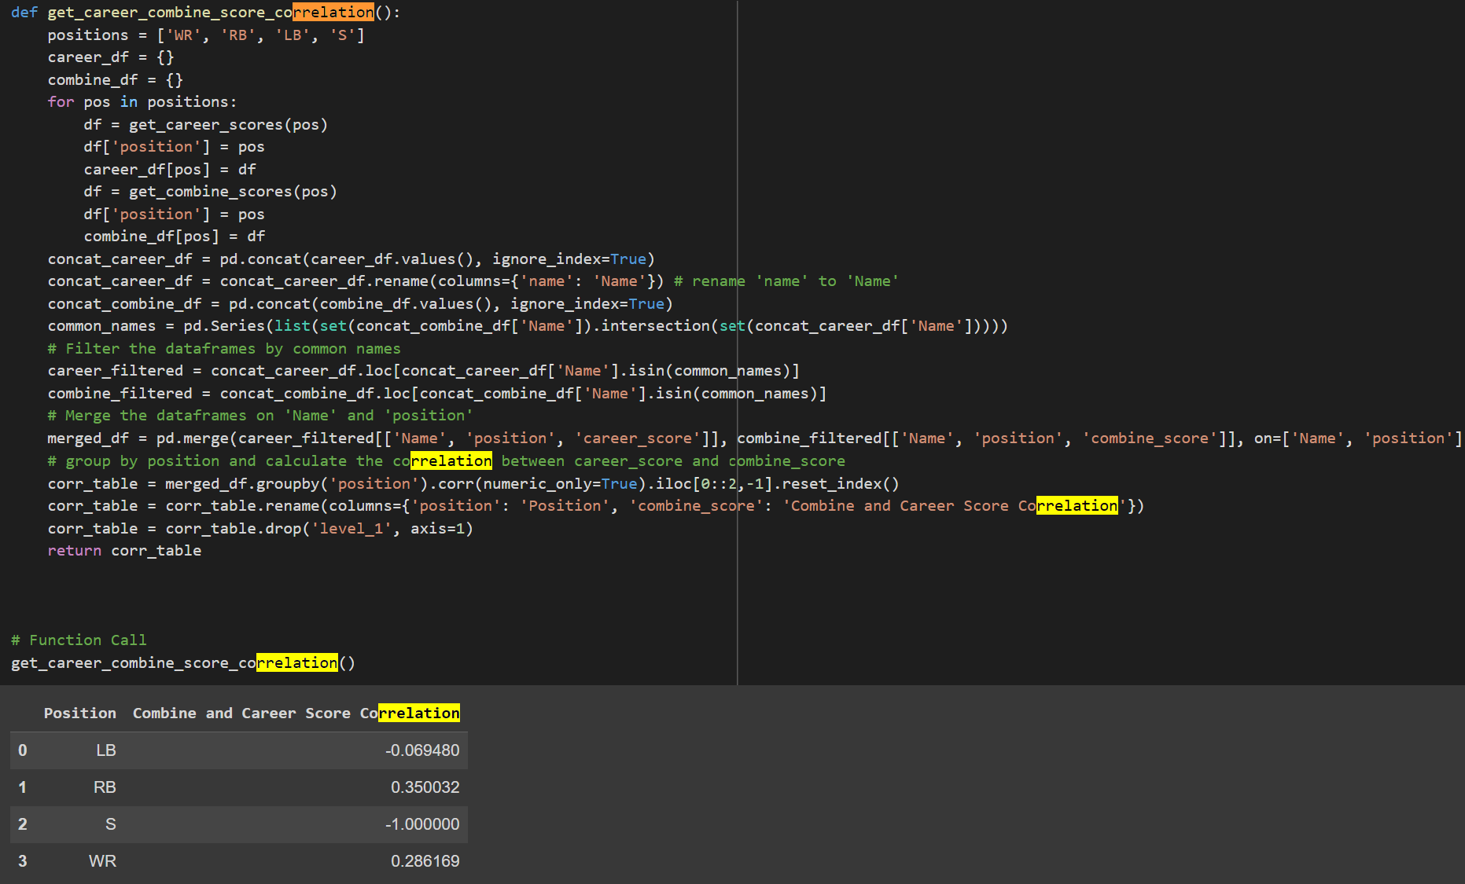
Correlation Table:

Slide 10
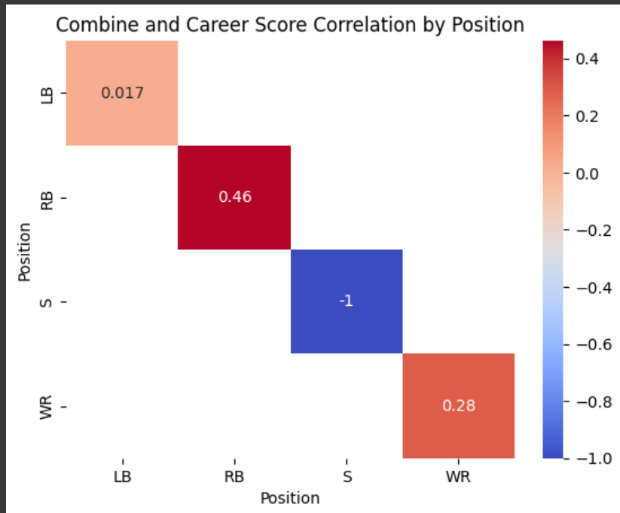
Visualization 1: Correlation Matrix
Based on our correlation table between combine score and career score by position, we created a correlation matrix of this table
Each correlation is color coded with deeper red being a stronger correlation and blue being smaller (more negative) correlation

Slide 11
Insight 2: Top Five Performers By Position
Next, we found the top five performers for each position. As seen on the next slide, most of the best combine performers do not go on to become high profile players. This result is consistent across all positions, suggesting that, while training for the combine is important, other preparations might need to take precedence over combine training when an NFL hopeful is preparing for the NFL.
Furthermore, these results suggest that NFL teams should use combine performances primarily to ensure a player does not have any glaring weaknesses than to discover new talent.

Slide 12
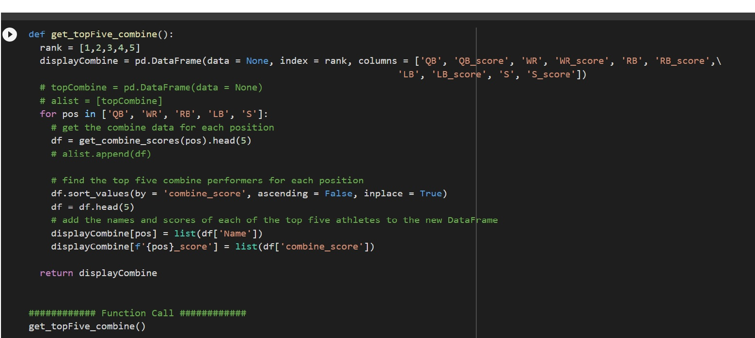
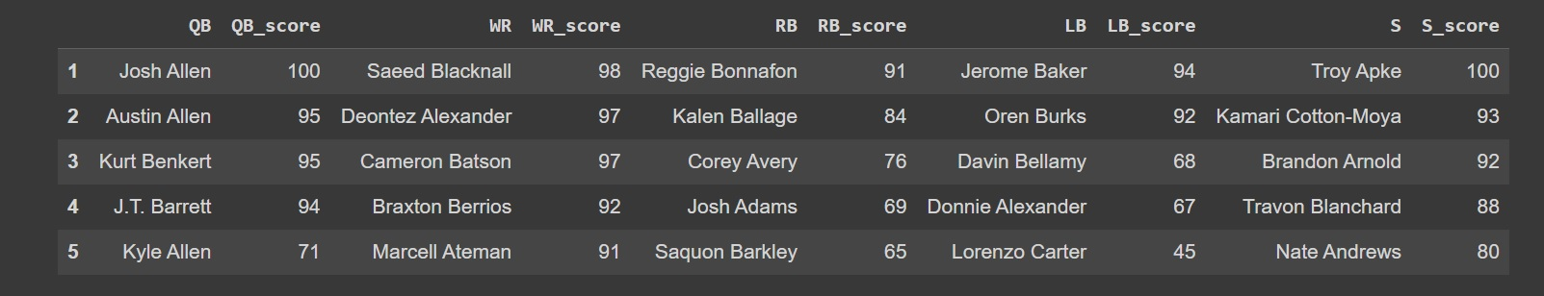
Top Five Performers:

Slide 13
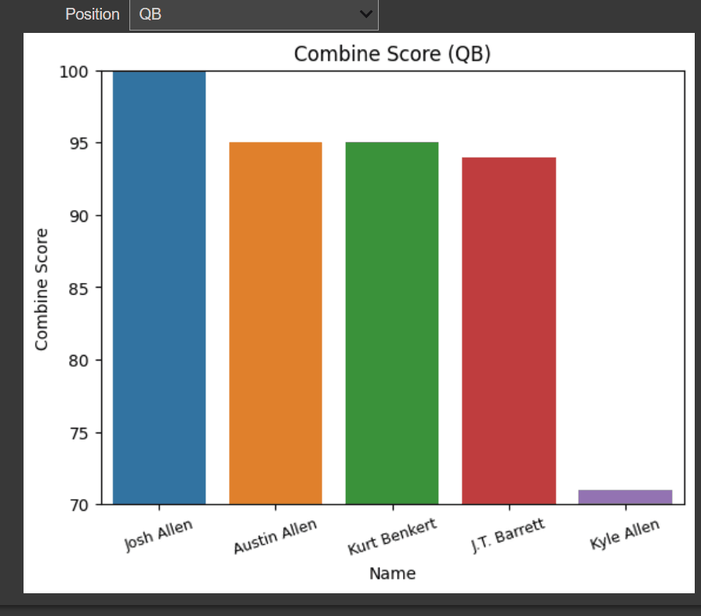
Visualization 2: Top Five Performers Bar Chart
Using the results of insight 2, we created an interactive bar chart that shows the combine score of the top five combine performers for each position. From the dropdown menu, you can select which position you are interested in.

Slide 14
Insight 3: Top 90% Touchdown scorers
We were interested in seeing which of the players who participated in the NFL combine in 2018 have scored the most touchdowns in the NFL.
We created a function that finds the top x (a parameter that is passed in ) percent of touchdown scorers for players who debuted in 2019. Passing in a value of 90 gave rather surprising results.
Unfortunately, the results of this insight revealed that statistics contained in the ESPN api do not accurately reflect a players true career statistics

Slide 15

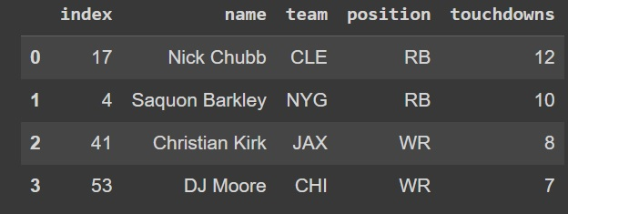
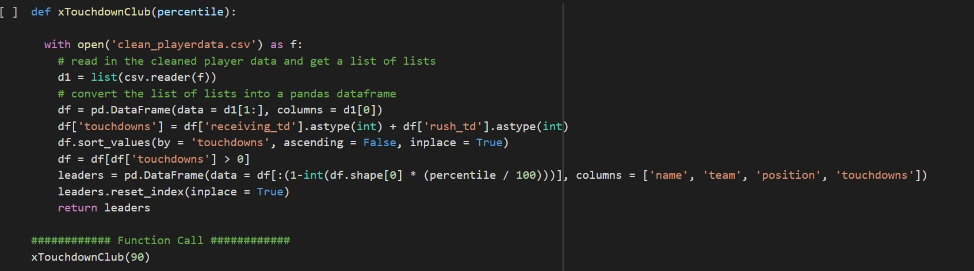
Top Scorers:
Meme credit: https://media.makeameme.org/created/suspect-something-is.jpg

Slide 16
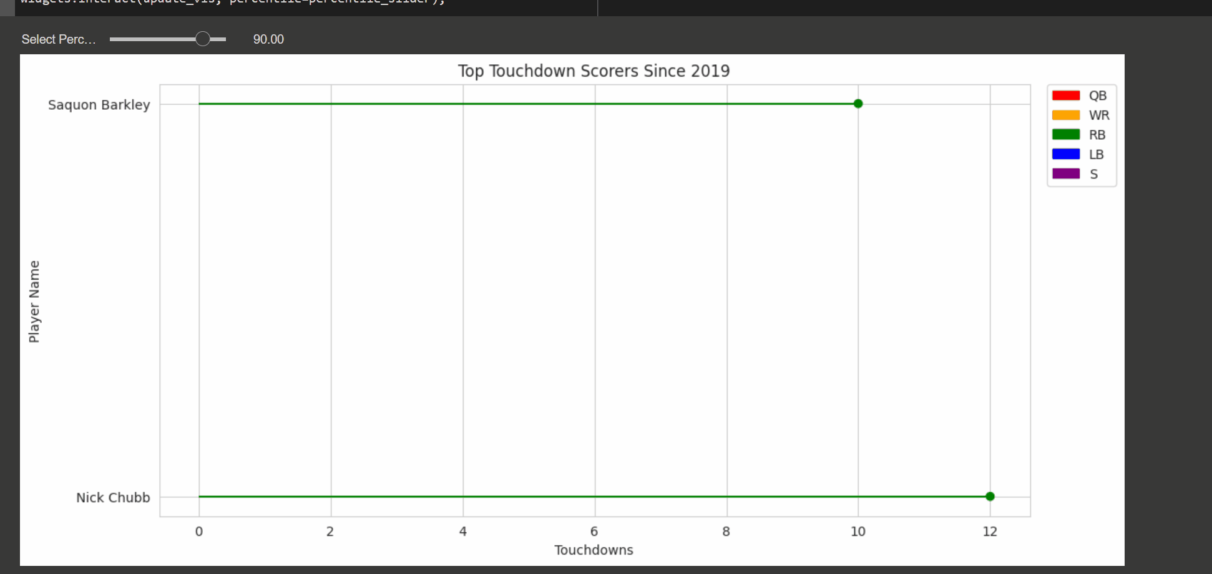
Visualization 3: Touchdown Lollipop Chart
Interactive visual shows the top x percent of touchdown leaders of players that debuted in 2018, where x is a percentile chosen by the slider above the graph The percent of touchdown leaders can be modified by using the slider widget

Slide 17
Insight 4: Extraordinary Athletes
What fun is looking at combine data if you don’t take a quick detour to see what athletic freaks showed in 2018? The NFL is known for athletes who are simultaneously incredibly fast and absurdly strong. We wanted to see who stood out most in this regard in 2018.
Our results show that there were 2015 athletes who competed in the 2018 combine that ran a sub 4.5 40 yard dash and bench press 225 lbs over 20 consecutive times.
Interestingly, despite the huge benefits of having both elite strength and speed, none of the athletes that made this list have gone on to become high profile NFL players.

Slide 18
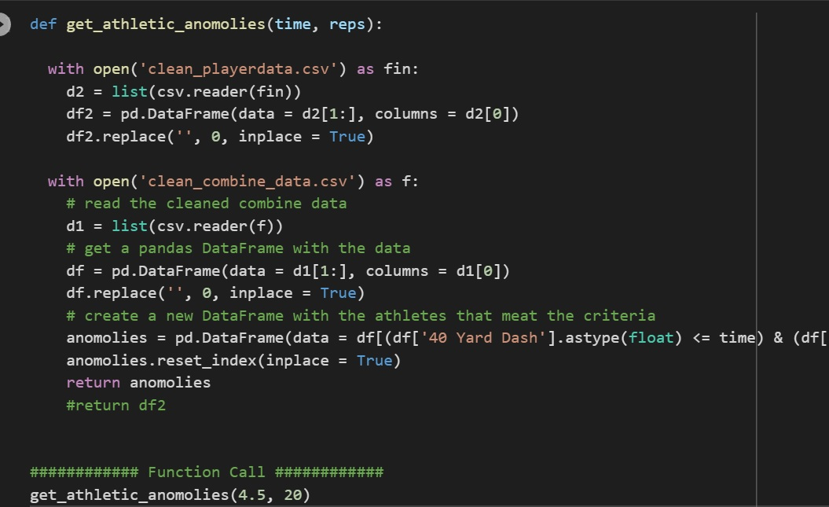
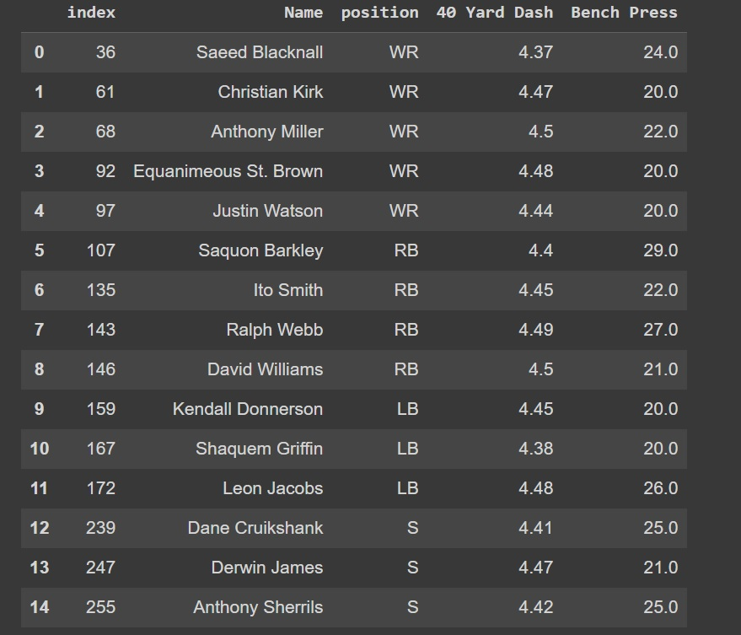
Athletic Anomalies:

Slide 19
Insight 5: Variance of 40 Yard Dash By Position
We were interested in how the speed of NFL athletes varies by position. Therefore, we found the variance of the 40 Yard Dash by Position. We found that variance is the largest for linebackers. This makes some sense because speed is not as big of a component of linebackers games compared to receivers, but we would have expected quarterbacks to have the greatest variance in speed since speed is arguably least important for them.
Positions like running backs and safety are going to want to be extra careful to make sure their 40 times do not fall below average since the small variance for their positions could make a poor performance stand out more than other positions.

Slide 20
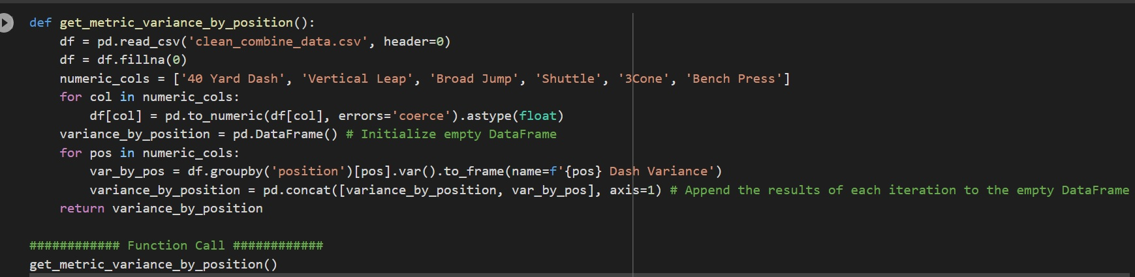
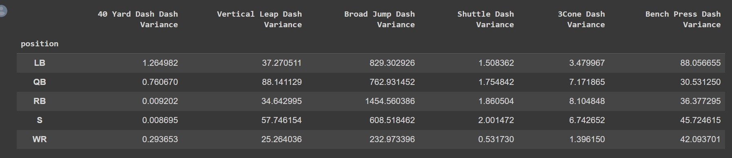
40 Yard Dash Variance:

Slide 21
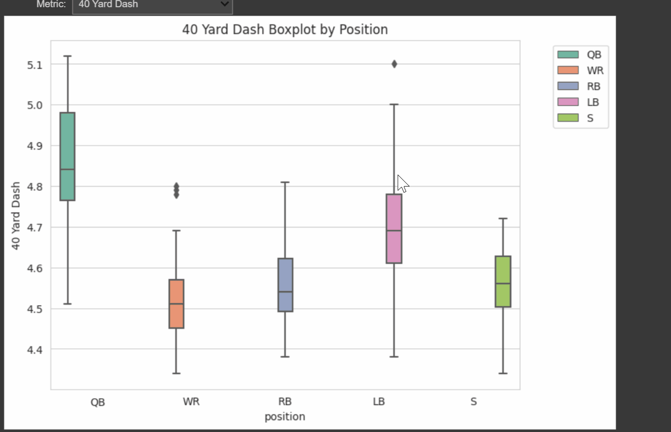
Visualization 4: Combine Drill Box Plot
Interactive visual shows boxplots for each combine drill and each position of interest. Using the dropdown menu, you can look at any drill metric you desire

Slide 22
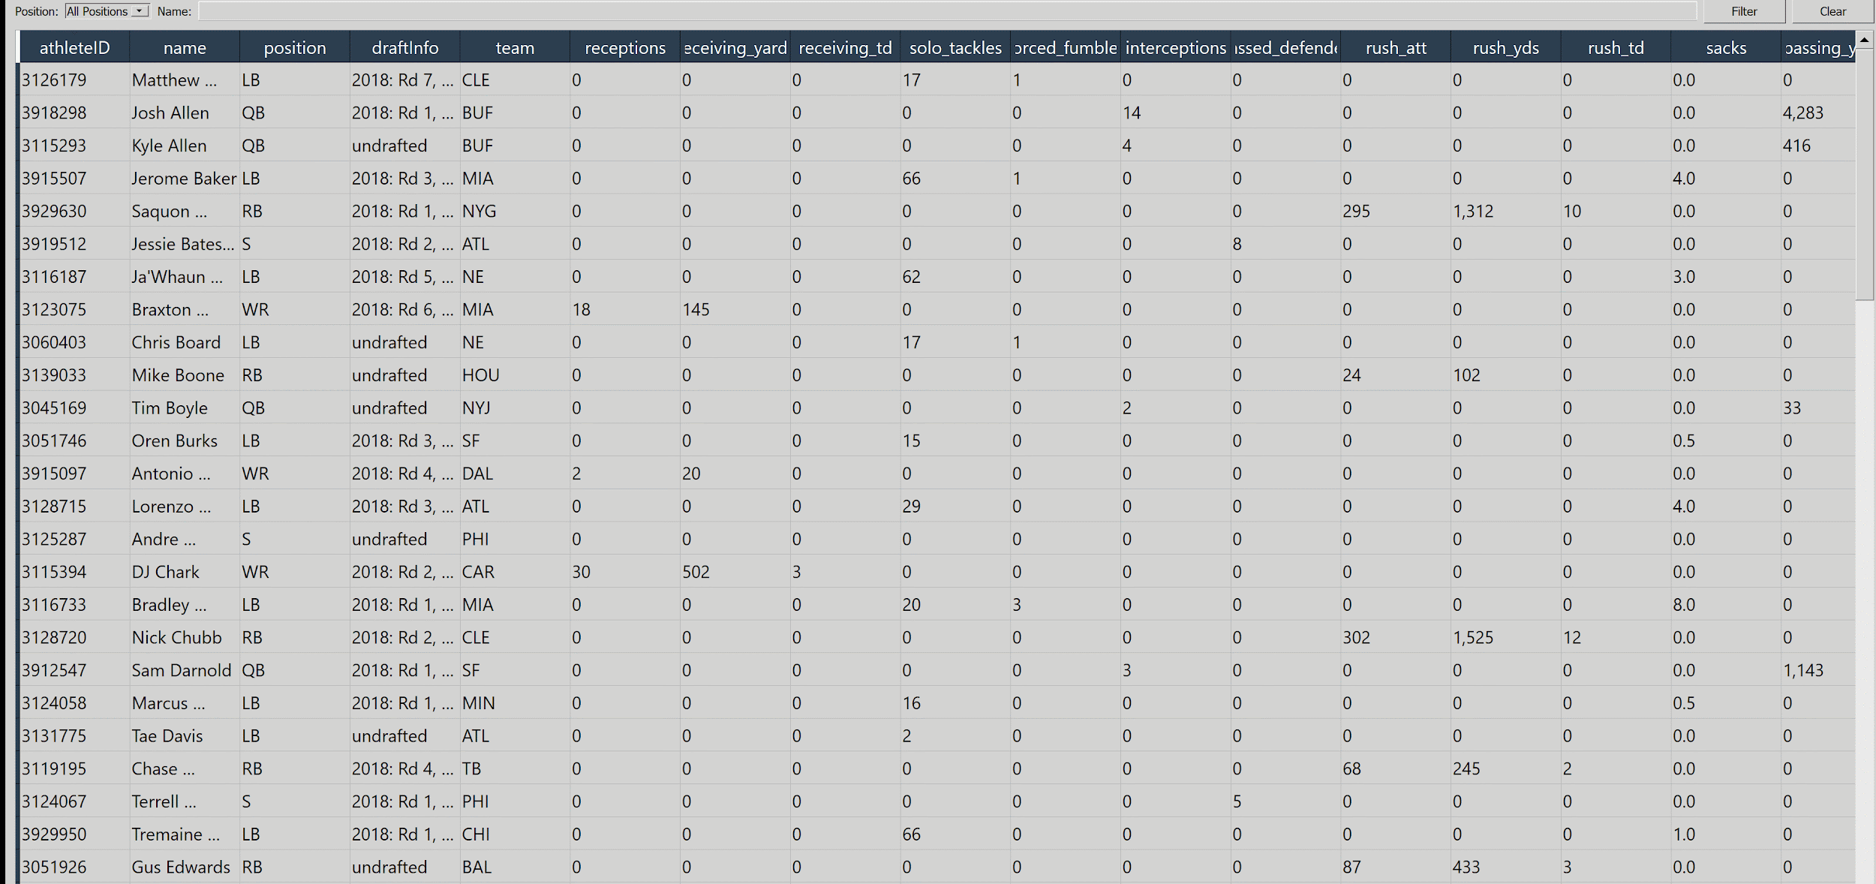
Graphical User Interface (GUI):
We made a GUI using PyQt 5, which allows the user to view the career performance statistics in a table. Users can search for a particular name or sort by position

Slide 23
Overall Results and Conclusion
Biggest challenge: finding the right data
Not only was finding data with helpful information a challenge, so was finding a large enough downloadable data set
Lessons learned:
Turning insights often presented in tabular format into compelling visuals
Finding the most efficient ways to reach many api endpoints
Creating helper functions that are standardized enough to help with multiple different insights rather than creating unique helper functions for each insight
Using:
Using Display and clear_output from IPython.display
Using FigureCanvasAgg from matplotlib.backends.backend_agg

